Slide 1
Battery Management for Standalone Solar-Power Lighting System
Based on IoT platform

Slide 2
Overview
A stand-alone solar-powered LED lighting system consists of a solar panel which generates electrical power and stores in battery, waiting to be discharged at night
The LED is turned on automatically at sunset when the sky is dark and turned off in the morning when the sky is bright. The open-circuit voltage of the PV module is used to detect the sunrise or sunset using a signal filter

Slide 3
Data Acquisition
PV Data Acquisition (from .csv files)
PV DC voltage and current
PV output profile
Lighting System Acquisition (from .csv files)
Lighting system load profile
Battery Pack Data Acquisition (from .csv files)
Battery Pack voltage
Battery Pack Current
Battery Pack Temperature

Slide 4



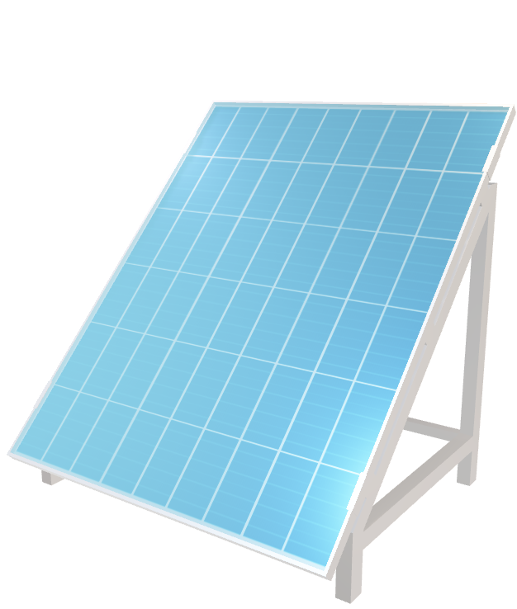

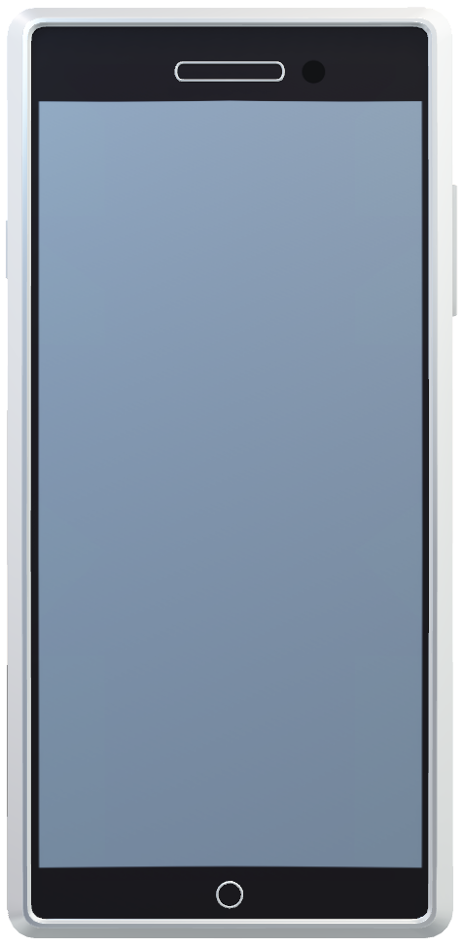

PV
Voltage Sensor
PV
Voltage Sensor
Battery
Voltage Sensor
PV
Current Sensor
PV
Current Sensor
Battery
Current Sensor
Analog to Digital Converter (ADC)
Data (from .csv files)
Abbreviation Description
SoC = State of Charge
DoD = Dept of discharge
SOH = State of health
Notification
Battery Status = Battery high temperature, please stop charging
Battery Current = A PV Current = A
Battery Voltage = V PV Voltage = V
SOC = %
DOD = %
SOH = %
Battery Temp = °C
Battery Status = Normal/ SOC too high/ DOD too low/ Battery high temperature
Battery Charging
Battery Current = A
PV Current = A
Battery Voltage = V
PV Voltage = V
SOC = %
DOD = %
Capacity = %
Battery Temp = °C
Battery Discharging
BMS Case
Contactor Open
Display
Open/Close Contactor
Emergency Button

Slide 5
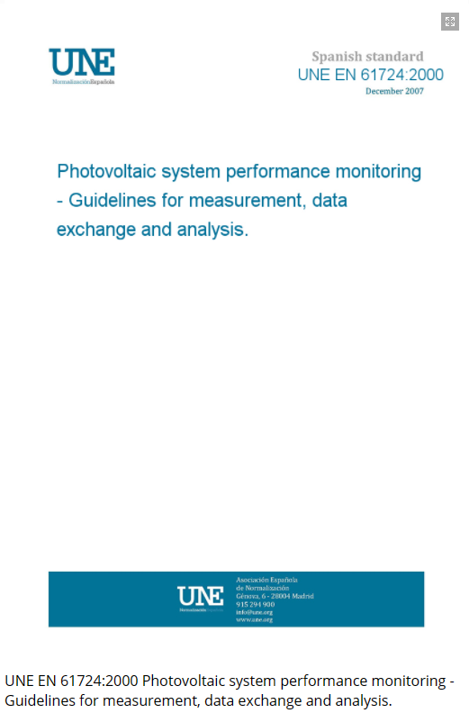
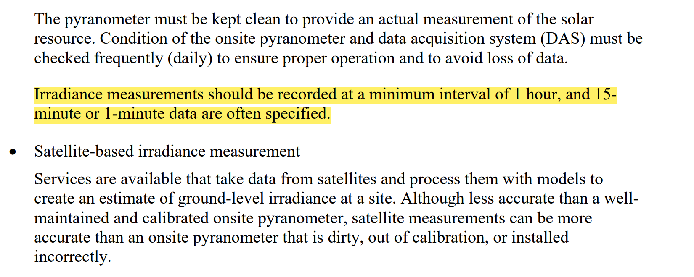
Features
Real-Time Measurement (via reading CSV files)
Reading PV generation profile
Lighting system load profile (constant power)
Sampling data every 2 seconds
(represents 1 minute time interval in the real system)
Maximum Samples: 1440 samples (24 hours)
Real-Time Calculation
Real-time Battery Charging/Discharging Current Calculation
Real-time SOC/DOD/SOH calculation
Real-time Battery Temperature Calculation
Monitoring/ Protection and Notification
Monitoring battery status to user via mobile app
Allow user to stop operation via mobile app
Allow user to stop operation via emergency button
Sampling frequency is defined according to UNE EN 61724:2000 standard

Slide 6
Scope and Limitation
This project illustrate the concept of very simple BMS
For safety issue, after the contactor is opened, battery shall not resume operation in any circumstances until it is checked by technicians
BMS does not support cloudy or dim conditions:
When PV output >0 → Lamp off and Battery must be charged(if ready)
When PV output = 0 → Lamp on and Battery must be discharge(if ready)
Battery can’t be charged and discharged simultaneously

Slide 7

Start
Check SOC, temperature of battery
Initialize Battery SOC, DOD and temperature
/Output profile of PV/ load profile of lighting system
Charge ready?
no
Sensing the solar panel voltage
Interrupt
yes
Solar Output >0
Yes
Start charging/green LED ON
User push emergency button on either mobile app or on BMS case
No
Check DOD, temperature of battery
no
Keep sensing SOC, temperature
Discharge ready?
no
yes
Over temp/SOC?
Turn-on the lighting calculate discharging current according to the load profile
Start discharging/ Yellow LED ON
yes
Keep sensing DOD, temperature
Over temp/DOD?
yes
Stop operation/open contactor/Red LED ON/ Notify user
*Note: For safety issue, after the contactor is opened, battery shall not resume operation in any circumstances until it is checked by technicians.
no
End

Slide 8
System Components
MCU: Arduino Atmega1280
The display: 5” LCD monitor with serial interface for data transfer
Mobile Control: a smart phone with NETPIE application
A push-button switch → Battery charging/Discharging interrupt

Slide 9
Tasks Overview
1) Data sourcing → acquire all the essential data from reliable sources
Relationship between output PV panel and time (in 24 hrs)
Relationship between energy usage of solar lamp and time (In 24 hrs)
Lead acid battery initial data voltage/ current / SOC/ SOH and Battery capacity
2) Data management and .CSV files generation
Convert all data into .csv files (1440 samples) and re-arrange them into a proper format
3) Software Development
Develop each software module (see next slide)
4) Software Functional Test
Test each software module
5) LCD study and development
Code LCD screen and connect to Arduino board
6) Integration Test
- Integrate all software modules together with LCD, push button and mobile and run final test

Slide 10
Software Development Breaks down
[SW-1.1] ReadPVParam
Description: Read PV generation profile CSV file and send it to Arduino software
Approach: TBD (SD card, NETPIE Cloud, etc.)
[SW-1.2] ReadLAMPParam
Description: Read Lighting load profile from CSV file and send it to Arduino software
Input: PV generation profile (CSV file)
Approach: TBD (SD card, NETPIE Cloud , etc.)
[SW-2.1] Function: OperateMode()
Input: Discrete value of solar PV generation, Previous state SOC, DOD, SOH, Temperature
Output: Battery is ready charged or discharged
[SW-2.2] Function: BattCurrCal()
Input: Discrete value of solar PV generation, Discrete value of lamp load
Output: Battery Charging current, Battery Discharging current
[SW-2.3] Function: BattParamCal()
Input: Previous state SOC, DOD, SOH, Temperature, Battery Charging current, Battery Discharging current
Output: Current state SOC DOD, SOH, Temperature, warning code and LED status
[SW-3.1]: UpdateDisplay()
Input: Current state SOC DOD, SOH, Temperature, warning code
Output: Update battery status on LCD display, warning message
[SW-3.2]: UpdateToNetpie()
Input: Current state SOC DOD, SOH, Temperature, warning code
Output: Update battery status on NETPIE, warning message
[SW-4] ISR: DisableOperation
Input: Physical/ Mobile push button, warning code
Output: Stop Charging/ Discharging and send notification to LCD/mobile, LED status
SW Section 1:
Data Acquisition and Operation Mode Selection
SW Section 2:
Battery parameters Calculation
SW Section 3:
Battery Status Update
SW Section 4:
Battery Protection

Slide 11
Project Timeline
Task | Week
 | 1 | 2 | 3 | 4 | 5 | 6 | 7 | 8 | 9
- Literature Review/ Data sourcing and data management - Documentation | x
- SW-1.1 - SW-1.2 Software functional test Documentation |  | x | x
- SW-2.1 - SW-2.2 - SW-2.3 Software functional test Documentation |  |  |  | x | x
- SW-3.1 - SW-3.2 - SW-4 Software functional test Documentation |  |  |  |  |  | x | x
- Integration Test -Documentation |  |  |  |  |  |  |  | x
Presentation |  |  |  |  |  |  |  |  | x

